Slide 1


PROPOSAL
TELEGRAM BOT PAYMENT
REPORT SYSTEM
ACTIVE INVESTMENT CO., LTD

Slide 2

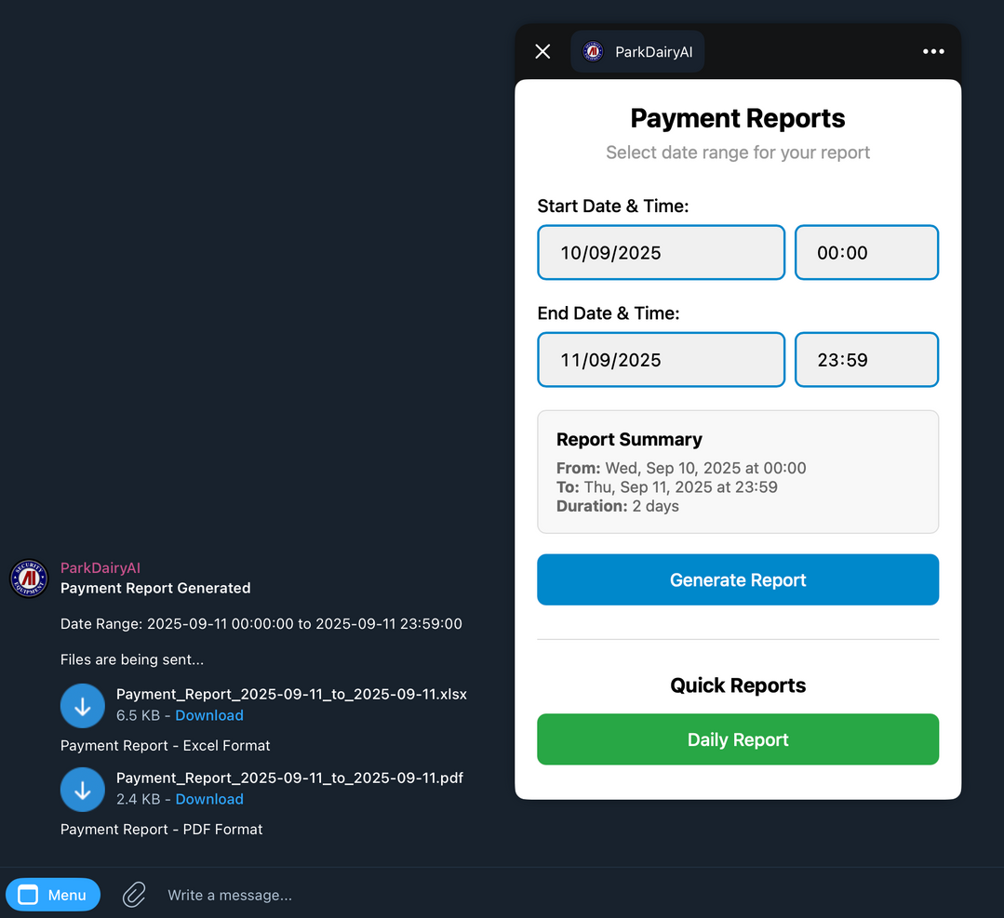
What we offer
1
Generate Payment Report Via Telegram
2
Quick Daily Report Option
3
Custom Range Date Report Option
4
Excel & PDF File Delivery
ACTIVE INVESTMENT CO., LTD
3

Slide 3
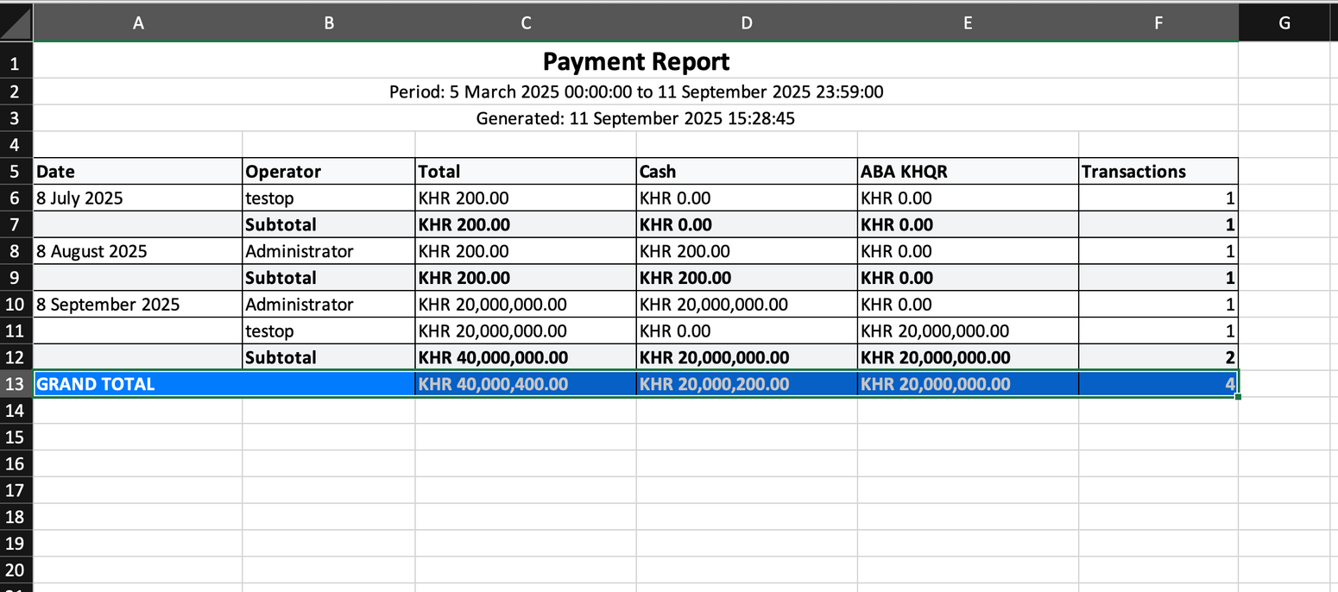
Excel Report
ACTIVE INVESTMENT CO., LTD
4

Slide 4
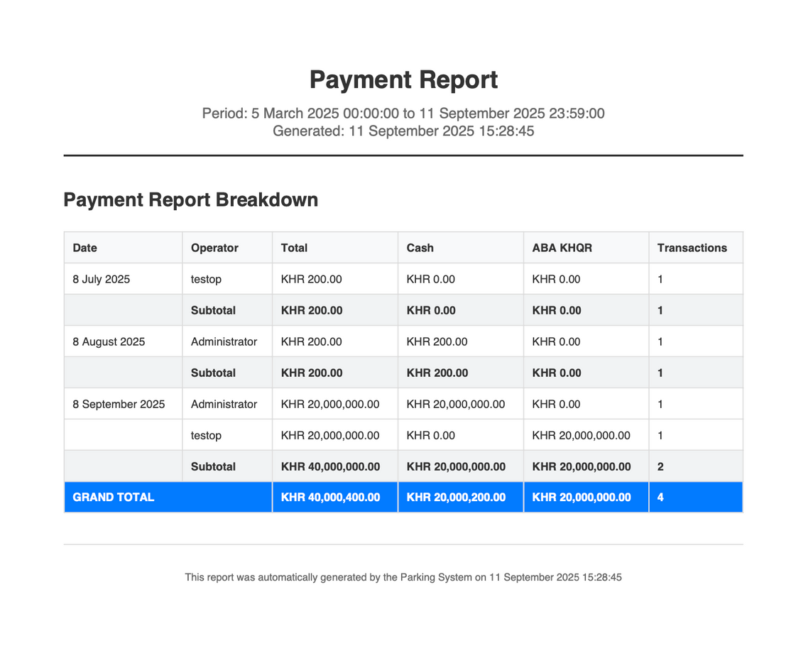
PDF Report
ACTIVE INVESTMENT CO., LTD
4

